Slide 1
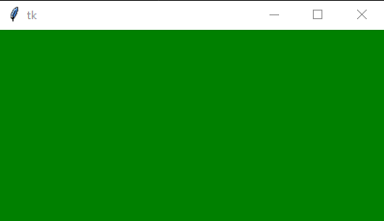
Exercise - Changing background color
Graphical User Interface -Tkinter
from tkinter import *
root = Tk()
# Set window size
root.geometry("400x200")
# Set window color
root.configure(bg='green')
root.mainloop()

Slide 2
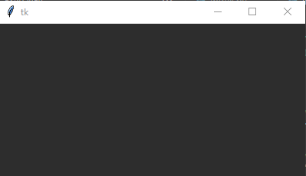
Exercise - Changing background color
Graphical User Interface -Tkinter
from tkinter import *
root = Tk()
# Set window size
root.geometry("400x200")
# Set window color
root['bg']='#2d2d2d'
root.mainloop()

Slide 3
Working with images
Install pillow library using any one of the following command based on your python version and os
pip install pillow
py -m pip install pillow
pip3 install pillow
Graphical User Interface -Tkinter

Slide 4
Working with images
To work with images on Python Tkinter we need to use
  PhotoImage
  Pillow Module
Graphical User Interface -Tkinter

Slide 5
Working with images - PhotoImage method
To insert image open an image using the following instruction
ImageTk.PhotoImage(Image.open("image"))
For example
img = ImageTk.PhotoImage(Image.open("Frozen.jpg"))
Create a widget object inside and pass the image inside the widget.
Graphical User Interface -Tkinter

Slide 6
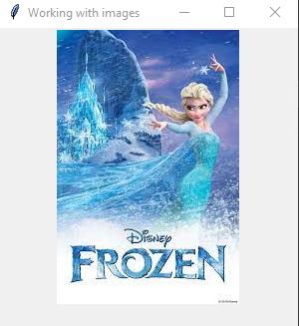
Exercise - Working with images
Graphical User Interface -Tkinter
# Import required libraries
from tkinter import *
from PIL import ImageTk, Image
# Create an instance of tkinter window
root = Tk()
# Define the geometry and title of the window
root.geometry("300x300")
root.title("Working with images")
# Create an object of tkinter ImageTk
img = ImageTk.PhotoImage(Image.open("Frozen.jpg"))
# Create a Label Widget to display the text or Image
label = Label(root, image = img)
label.pack()
root.mainloop()

Slide 7
Exercise - Working with images
Graphical User Interface -Tkinter
# Import required libraries
from tkinter import *
from PIL import ImageTk, Image
# Create an instance of tkinter window
root = Tk()
# Define the geometry and title of the window
root.geometry("300x300")
root.title("Working with images")
# Create an object of tkinter ImageTk
img = ImageTk.PhotoImage(Image.open("Frozen.jpg"))
# Create a Label Widget to display the text or Image
label = Label(root, image = img)
label.pack()
root.mainloop()

Slide 8
Exercise - Working with images
Display the image into the root window using PhotoImage function
Extension (Optional) - Resize the image2 as - (100,100)
Hint : Use resize() function
Graphical User Interface -Tkinter

Slide 9
Graphical User Interface -Tkinter
Code to Resize Image- (Extension)
#Resize the Image using resize method
resized_image= img.resize((100,100))
new_image= ImageTk.PhotoImage(resized_image)
Notes:
100 pixels wide and 100 pixels high

Slide 10
Working with images - image resizing
To resize image
load image
img= Image.open("pizza.jpg")
Resize the image
resized_image= img.resize((100,100))
Open the resized image using PhotoImage
new_image= ImageTk.PhotoImage(resized_image)
Display image using Label
Label(root,image=new_image).pack()
Graphical User Interface -Tkinter

Slide 11
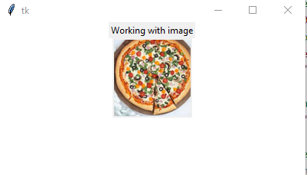

Exercise - Working with images
Graphical User Interface -Tkinter
from tkinter import *
from PIL import ImageTk, Image
root = Tk()
# Set window size
root.geometry("400x200")
# Set window color
root['bg']='white'
Label(root,text="Working with image").pack()
#Load an image in the script
img= Image.open("pizza.jpg")
#Resize the Image using resize method
resized_image= img.resize((100,100))
new_image= ImageTk.PhotoImage(resized_image)
Label(root,image=new_image).pack()
root.mainloop()

Slide 12
03
Working with Files

Slide 13
Working with Files
01
02
File Handling
Regular Expressions
Learn to work with files
Read data from files
Write data to files
Understand how to use regular expressions for text
Searching or string replacement

Slide 14
Objectives
Learn to work with files
Read data from files
Write data to files
Understand how to use regular expressions for text searching or string replacement
Tkinter - Working with Files and Strings

Slide 15
File Handling
Python provides built-in functions for
opening a file
reading from a file
writing to a file
closing a file
Tkinter - Working with Files and Strings

Slide 16
File Handling
What Are Files?
A file is a collection of data or information that is stored on a computer or other storage device (like a hard drive or USB).
You can think of a file as a digital container that holds information — text, images, videos, code, etc.
Tkinter - Working with Files and Strings

Slide 17
File Handling
All files must be opened first before they can be read from or written to using the Python’s built-in open() function.
When a file is opened using open() function, it returns a file object called a file handler that provides methods for accessing the file.
It is important to close the file once the processing is completed.
Tkinter - Working with Files and Strings

Slide 18
File Handling - Opening and Closing text files
Syntax:
file_handler = open(filename, mode)
file_handler - file object
filename - the file to be opened
mode - r -read,w-write,a-append…
file_handler.close()
Tkinter - Working with Files and Strings

Slide 19
File Handling - Opening text files using with
Syntax:
with open (file, mode) as file_handler:
Statement_1
Statement_2
. . .
Statement_N
It is not required to close file if it is opened using with statement
Tkinter - Working with Files and Strings

Slide 20
File Handling - Reading text files
Open a file using open() function.
Read the content using methods like read(), readline(), or readlines().
Tkinter - Working with Files and Strings

Slide 21
read()
Purpose: Reads the entire content of the file as a single string.
readline()
Purpose: Reads a single line from the file each time it is called.
readlines()
Purpose: Reads all the lines in a file and returns them as a
list of strings, where each string represents a line.

Slide 22
File Handling - Reading text files using read()
Syntax
file_handler. read([size])
This method is used to read the contents of a file up to a size and return it as a string.
The argument size is optional, and, if it is not specified, then the entire contents of the file will be read and returned
Tkinter - Working with Files and Strings

Slide 23
File Handling - Reading text files using read()
Tkinter - Working with Files and Strings
#Open the file ReadFile1.txt
with open('ReadFile1.txt') as file_handler:
contents = file_handler.read()
#contents hold the entire data of the file
print(contents)

Slide 24
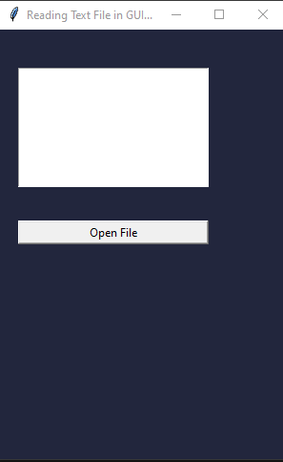
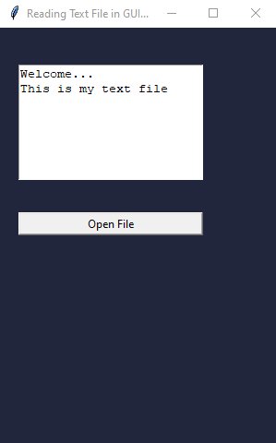
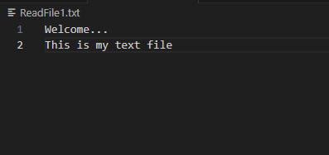
Exercise
Click Here For
Code file

Slide 25
Exercise
#Create text area to read contents from the file
txtarea = Text(main, width=40, height=10)
txtarea.place(x=20, y=40, height=125, width=200)
#Create a button to open the file
Button(
main,
text="Open File",
command=openFile
).place(x=20, y=200, height=25, width=200)

Slide 26
Exercise
def openFile():
#Open the file rak.txt
with open('ReadFile1.txt') as file_handler:
contents = file_handler.read()
#Dispaly contents from file into the text widget
txtarea.insert(END, contents)
print(contents) #Print contents on console
#Ensure that Text area is empty for each button click
txtarea.delete("1.0","end")

Slide 27
Exercise
def openFile():
#Open the file rak.txt
with open('ReadFile1.txt') as file_handler:
contents = file_handler.read()
#Dispaly contents from file into the text widget
txtarea.insert(END, contents)
print(contents) #Print contents on console
#Ensure that Text area is empty for each button click
txtarea.delete("1.0","end")

Slide 28
File Handling - Reading text files using read()
Tkinter - Working with Files and Strings
#Create text area to read contents from the file
txtarea = Text(main, width=40, height=10)
txtarea.place(x=20, y=40, height=125, width=200)
#Create a button to open the file
Button(
main,
text="Open File",
command=openFile
).place(x=20, y=200, height=25, width=200)

Slide 29
File Handling - Reading text files using read()
Tkinter - Working with Files and Strings
#Create text area to read contents from the file
txtarea = Text(main, width=40, height=10)
txtarea.place(x=20, y=40, height=125, width=200)
#Create a button to open the file
Button(
main,
text="Open File",
command=openFile
).place(x=20, y=200, height=25, width=200)
# Function call on Button Click
def openFile():
#Ensure that Text area is empty
txtarea.delete("1.0","end")
#Open the file rak.txt
with open('ReadFile1.txt') as file_handler:
contents = file_handler.read()
#Dispaly contents from file into the text area widget
txtarea.insert(END, contents)
print(contents) #Print contents on console window

Slide 30
from tkinter import *
from tkinter import filedialog
main = Tk()
main.title("Reading Text File in GUI window")
main.geometry("300x450")
main['bg']='#22263d'
def openFile():
#Ensure that Text area is empty
txtarea.delete("1.0","end")
#Open the file new.txt
with open('C:\\Users\\DELL\\Desktop\\new.txt') as file_handler:
contents = file_handler.read()
#Dispaly contents from file into the text area widget
txtarea.insert(END,contents)
print(contents) #Print contents on console window
#Create text area to read contents from the file
txtarea = Text(main, width=40, height=10)
txtarea.place(x=20, y=40, height=125, width=200)
#Create a button to open the file
Button(
main,
text="Open File",
command=openFile
).place(x=20, y=200, height=25, width=200)
main.mainloop()
Code:

Slide 31
Exercise
To add scroll bar on text widget
# Add a Scrollbar(vertical)
scrollV=Scrollbar(main, orient='vertical')
scrollV.place(x=220,y=40,height=125)
scrollV.config(command=txtarea.yview)
txtarea.config(yscrollcommand=scrollV.set)

Slide 32
File Handling -Reading text files line by line
Tkinter - Working with Files and Strings
#Open the file rak.txt
#printing the file contents line by line
print("Printing each line in text file")
with open(new.txt") as file_handler:
for each_line in file_handler:
print(each_line)
We use the with syntax to let Python open and close the file properly.
To examine the file’s contents, we work through each line in the file by looping over the file object
Note : The blank lines appear because an invisible newline character is at the end of each line in the text file.

Slide 33
File Handling -Reading text files line by line removing blank lines
Tkinter - Working with Files and Strings
#Open the file rak.txt
#printing the file contents line by line
print("Printing each line in text file")
with open(“new.txt") as file_handler:
for each_line in file_handler:
print(each_line.rstrip())
Using rstrip() on each line in the print() call eliminates these extra blank lines

Slide 34
File Handling -Reading text files using readline()
Syntax : file_handler.readline()
This method is used to read a single line in file
Tkinter - Working with Files and Strings
#Open the file rak.txt
with open(“new.txt") as file_handler:
print("Print a single line from the file")
print(file_handler.readline(), end="")
print("Print another single line from the file")
print(file_handler.readline(), end="")

Slide 35
File Handling -Reading text files by Making a List of Lines from a File
Tkinter - Working with Files and Strings
#Open the file rak.txt
#printing the file contents line by line
print("Printing each line in text file")
with open(“new.txt") as file_handler:
lines = file_handler.readlines()
for each_line in lines:
print(each_line.rstrip())
readlines() method takes each line from the file and stores it in a list.
This list is then assigned to lines, which we can continue to work
with after the with block ends.
A simple for loop is used to print each_line from lines. Because each item in lines corresponds to each line in the file, the output matches the contents of the file exactly.

Slide 36
Exercise
Working with a File’s Contents
Create a file num.txt add 5 digits to it , one digit in a line.
create a variable num_string to hold the digits of num.txt.
Using a loop add each line of digits to num_string and then print this string and also show how long the string is

Slide 37
Exercise
CODE
https://docs.google.com/document/d/1CQxd7y40VVdnm9_bzBqIK6_mlkeXLQk3l9ExompT_zw/edit
def openFile():
with open("num.txt") as file_handler:
lines = file_handler.readlines()
num_string = ''
for each_line in lines:
num_string += each_line.rstrip() + ' '
txtarea.insert(END, num_string)
txtarea.insert(END, f"\nThe length of the string is {len(num_string)}")

Slide 38
from tkinter import *
from tkinter import filedialog
main = Tk()
main.title("Reading Text File in GUI window")
main.geometry("300x450")
main['bg']='#22263d'
global num_string
def openFile():
with open("C:\\Users\\DELL\\Desktop\\new.txt") as file_handler:
lines = file_handler.readlines()
num_string = '‘ ”
for each_line in lines:
num_string += each_line.rstrip() + ' '
print(num_string) #prints num_string
txtarea.insert(END, num_string)
print(len(num_string)) #prints length of string
txtarea.insert(END, f"\nThe length of the string is {len(num_string)}")d
#create a label
heading = Label(main, text="To Read from the file into the textarea below,\nclick the button:", font=('Roboto', 10),fg="#FFFFFF" ,bg="#22263d")
heading.place(x=20,y=10)
#Create text area to read contents from the file
txtarea = Text(main)
txtarea.place(x=20, y=60, height=125, width=250)
#Create a button to open the file
Button(
main,
text="Open File",
command=openFile
).place(x=20, y=200, height=25, width=250)
main.mainloop()

Slide 39
File Handling -Writing to the file
Tkinter - Working with Files and Strings
CODE:
https://docs.google.com/document/d/1-LlRLCi3bUziM1ksmCdtlxP598cjy-jxG_ea4cBo1Pk/edit?usp=sharing
#Writing to the file
filename = 'programming.txt'
with open(filename, 'w') as file_handler:
file_handler.write("I love programming.")
To write text to a file, you need to call open() with a second argument telling Python that you want to write to the file

Slide 40
def openFile():
#Ensure that Text area is empty
txtarea.delete("1.0","end")
#Open the file new.txt
with open('C:\\Users\\DELL\\Desktop\\new.txt') as file_handler:
content = file_handler.read()
updated_content = content + "\nmy name is Ann"
# Write the updated content back to the file
with open("C:\\Users\\DELL\\Desktop\\new.txt", 'w') as file_handler:
file_handler.write(updated_content)
txtarea.insert(END,content)
print(content) #Print contents on console window

Slide 41
from tkinter import *
from tkinter import filedialog
main = Tk()
main.title("Reading Text File in GUI window")
main.geometry("300x450")
main['bg']='#22263d'
def openFile():
#Ensure that Text area is empty
txtarea.delete("1.0","end")
#Open the file new.txt
with open('C:\\Users\\DELL\\Desktop\\new.txt') as file_handler:
content = file_handler.read()
updated_content = content + "\nmy name is Ann"
# Write the updated content back to the file
with open("C:\\Users\\DELL\\Desktop\\new.txt", 'w') as file_handler:
file_handler.write(updated_content)
txtarea.insert(END,content)
print(content) #Print contents on console window
#Create text area to read contents from the file
txtarea = Text(main, width=40, height=10)
txtarea.place(x=20, y=40, height=125, width=200)
#Create a button to open the file
Button(
main,
text="Open File",
command=openFile
).place(x=20, y=200, height=25, width=200)
main.mainloop()

Slide 42
File Handling - Writing to an Empty File multiple lines
Tkinter - Working with Files and Strings
#Writing to the file
filename = 'programming.txt'
with open(filename, 'w') as file_handler:
file_handler.write("I love programming.")
file_handler.write("I love creating new games.")
You can write multiple lines using write()

Slide 43
File Handling -Appending to a File
Tkinter - Working with Files and Strings
#Writing to the file
filename = 'programming.txt'
with open(filename, 'a') as file_handler:
file_handler.write("I also love finding meaning in large datasets\n")
file_handler.write("I love creating apps that can run in a browser.\n")
You can write multiple lines using write()

Slide 44
Exercise
Search for a string in the file in numbers.txt find the number in the file.
Hint : Convert the file contents to string and find using if- in statement

Slide 45
Exercise
#Searching in the file
filename = 'numbers.txt'
pi_string = ''
with open(filename) as file_object:
lines = file_object.readlines()
for line in lines:
pi_string += line.strip()
number = input("Enter the number to be searched ")
if number in pi_string:
print("Found the number in string")
else:
print("Number not found.")

Slide 46
from tkinter import *
from tkinter import filedialog
root=Tk()
root.title("File Handling")
root.geometry("500x500")
root.configure(bg="#167AAB")
def openFile():
global pi_string
pi_string = ''
with open("C:\\Users\\DELL\\Desktop\\new.txt") as file_object:
lines = file_object.readlines()
for line in lines:
pi_string += line.strip()
number = input("Enter the number to be searched ")
if number in pi_string:
print("Found the number in string")
else:
print("Number not found.")
txtarea=Text(root)
txtarea.place(x=20,y=40,height=125,width=200)
btn=Button(root,text="open file",command=openFile)
btn.place(x=20,y=200,height=25,width=200)
root.mainloop()

Slide 47
Develop a Python program using the Tkinter module to create a user-friendly Registration Form application.
The form should collect essential details from the user, perform basic validation, and display the entered information upon submission.
Create the Main Window
  Title: "Registration Form"
  Suitable window size (e.g., 400x400)
  Background color , an image of your choice.
Add Input Fields
  Full Name → Use a Label and Entry widget.
  Email → Use a Label and Entry widget.
  Gender → Use Radiobutton widgets for options like Male and Female.
  Country → Use an OptionMenu or Combobox with options such as UAE, India, USA, UK, Canada.
  Register button
    Validate that no field is empty.
Use Layout Manager
  Arrange all widgets properly
Enhance User Experience
  Use readable fonts, alignment, and spacing.
  Optionally, change background colors or button colors to improve the desig

Slide 48
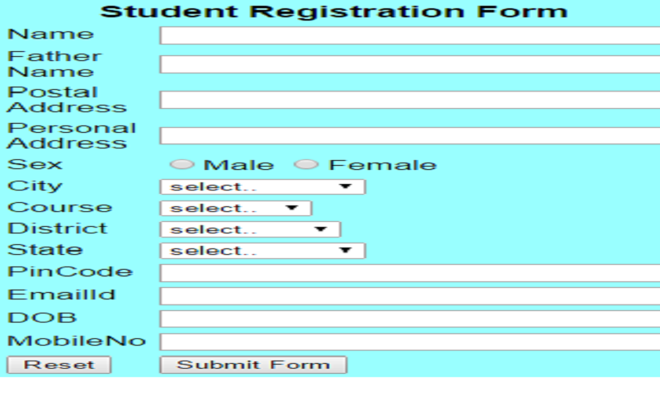

Slide 49
Thank You

